Slide 1
System Model Framework Introduction zhu enqing

Slide 2
contents
1.Concept of System Model
2.System Model High Level Functional Partition
3. BTS Module High Level Functional Partition
4. Downlink High Level Data Flow Description
5. Uplink High Level Data Flow Description
6. UL Timing
7. DL Timing
<number> | zCEM SW architecture | May 2009

Slide 3
1 Concept of System Model
System Model is a simulation model of the actual board level FPGAs, DSP, and buses channel elements, which perform Layer 1 (plus selected Layer 2) processing for 3GPP standards.
System Model runs on Sun’s OS, Solaris. Its hardware architecture is SUN Sparc processor. It is written in C++.
Although the SM is developed to be a bit-exact and timing-exact model, it is, at root an algorithmic model of a communication system, and not board hardware.
  Align to Algorithm document about fixed point processing
  One subframe is divided into 16 ticks(1/16th of a 1 ms = 62.5ms ) and the processing is ticks based.
<number> | zCEM SW architecture | May 2009

Slide 4
contents
1.Concept of System Model
2.System Model High Level Functional Partition
3. BTS Module High Level Functional Partition
4. Downlink High Level Data Flow Description
5. Uplink High Level Data Flow Description
6. UL Timing
7. DL Timing
<number> | zCEM SW architecture | May 2009

Slide 5
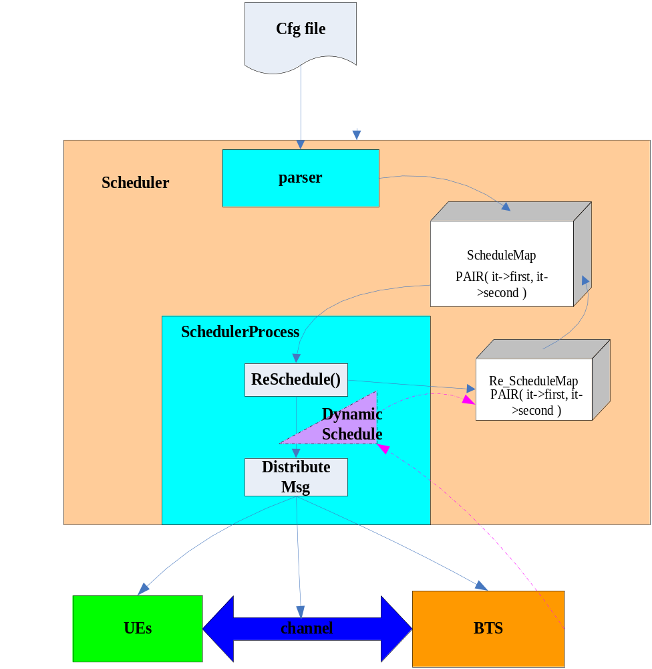
2.System Model High Level Functional Partition
1 input:
Cfg file: Define the test case. Include all the message and time to trig the UEs, Channel, and BTS.
4 main Objects:
Scheduler: Control the whole simulation. Parse the cfg file and distribute the message to trig the other objects.
UEs: Simulate the UEs. Generate the uplink data according to the message.
Channel: Simulate the channels. Include Wired Channel; Spatial Channel; Jakes Model;
BTS: Simulate the BTS L1;
<number> | zCEM SW architecture | May 2009

Slide 6
contents
1.Concept of System Model
2.System Model High Level Functional Partition
3. BTS Module High Level Functional Partition
4. Downlink High Level Data Flow Description
5. Uplink High Level Data Flow Description
6. UL Timing
7. DL Timing
<number> | zCEM SW architecture | May 2009

Slide 7
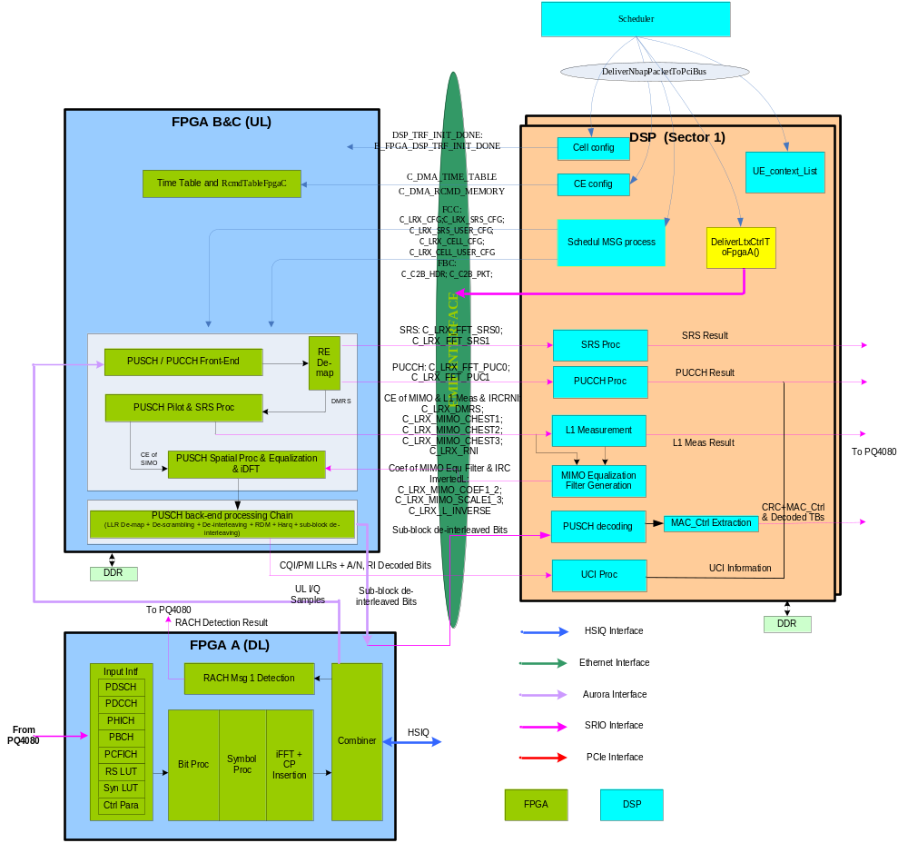
3. BTS Module High Level Functional Partition
5 main objects:
FPGA-A: DL+Rach;
FPGA-B: DCC;
FPGA-C: Front end + CE + EQU;
DSPA: SRS+PUC+Mea+ Message parse;
EMIFB interface;
<number> | zCEM SW architecture | May 2009

Slide 8
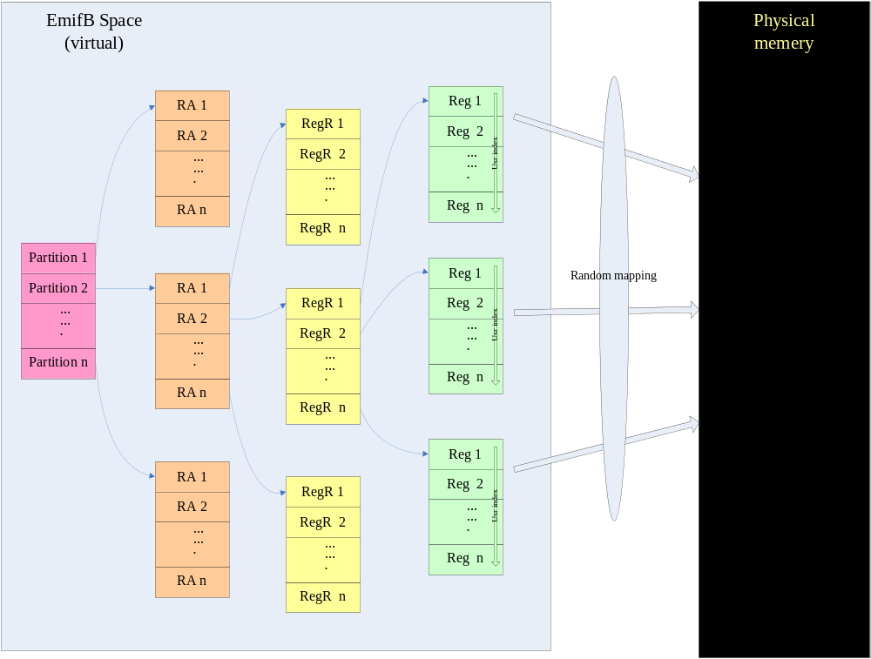
3. BTS Module High Level Functional Partition
EMIFB interface:
Access method:
SrioWrite/SrioOp (Continuous Buffer Write)
FpgaRegisterWrite/EmifBRegisterWrite(Single register Write)
FpgaRegisterRead/EmifBRegisterRead(Single register Read)
FpgaFieldWrite/EmifBFieldWrite(Filed level Write)
FillField(Field Assembling)
GetField(Field disassembling)
<number> | zCEM SW architecture | May 2009

Slide 9
contents
1.Concept of System Model
2.System Model High Level Functional Partition
3. BTS Module High Level Functional Partition
4. Downlink High Level Data Flow Description
5. Uplink High Level Data Flow Description
6. UL Timing
7. DL Timing
<number> | zCEM SW architecture | May 2009

Slide 10
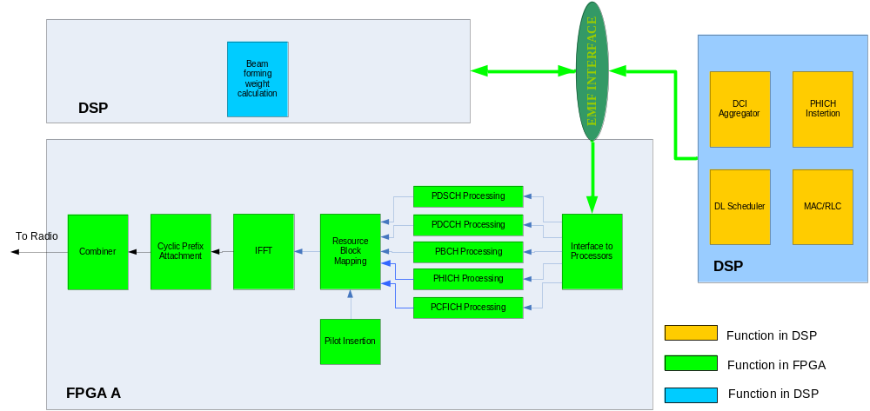
4. Downlink High Level Data Flow Description
<number> | zCEM SW architecture | May 2009

Slide 11
contents
1.Concept of System Model
2.System Model High Level Functional Partition
3. BTS Module High Level Functional Partition
4. Downlink High Level Data Flow Description
5. Uplink High Level Data Flow Description
6. UL Timing
7. DL Timing
<number> | zCEM SW architecture | May 2009

Slide 12
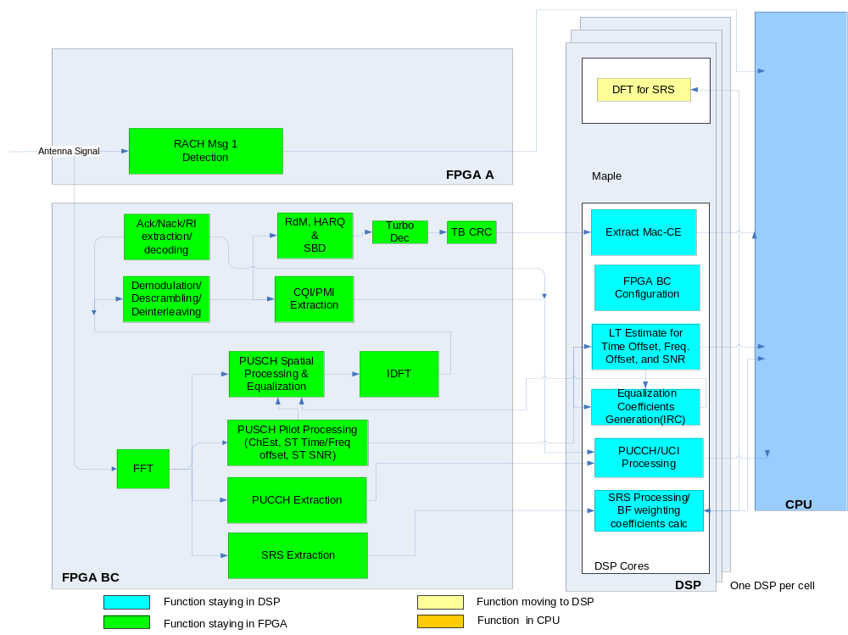
5. Uplink High Level Data Flow Description
<number> | zCEM SW architecture | May 2009

Slide 13
contents
1.Concept of System Model
2.System Model High Level Functional Partition
3. BTS Module High Level Functional Partition
4. Downlink High Level Data Flow Description
5. Uplink High Level Data Flow Description
6. UL Timing
7. DL Timing
<number> | zCEM SW architecture | May 2009

Slide 14
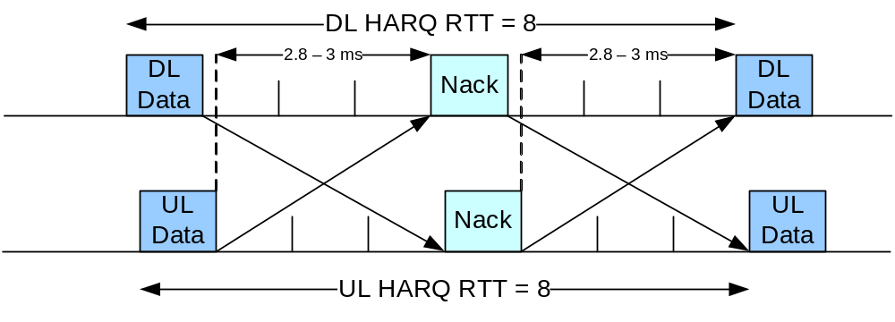
6. UL Timing
    High Level Timing Requirements
<number> | zCEM SW architecture | May 2009

Slide 15
6. UL Timing
TICK
There are some types of parameters which related with tick
Nib: the sample data of Antenna data. In BW = 20MHz,it is 30720000 for a subframe.
Tick : simulates as 1/16 ms
LBidxCount : Symbol index which is 1/14 ms interval, used in FPGA C
Slot : 8 ticks
Subframe : 16 ticks
Frame : 160 ticks
FRAMES_PER_BFN_ROLL : 4096 frame
<number> | zCEM SW architecture | May 2009

Slide 16
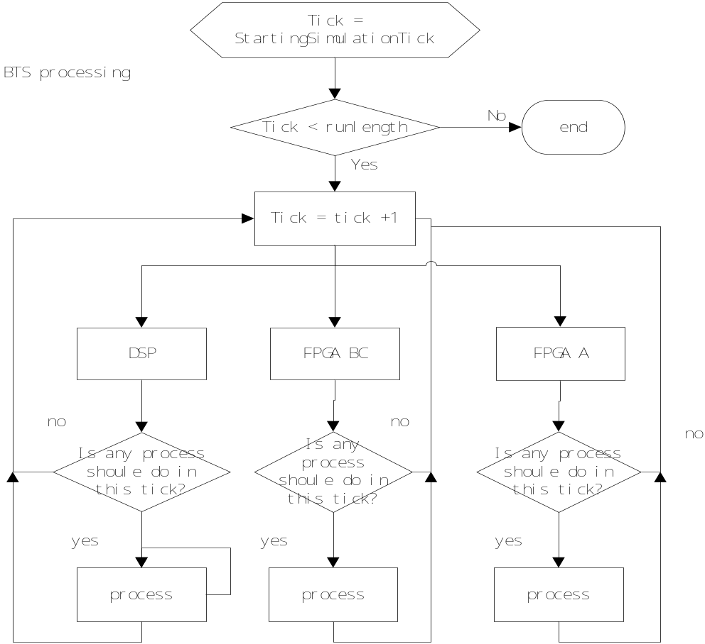
6. UL Timing
TICK
System model simulates the running of modules in a ticks based mothed.
Every processing of modules or functions has a tick label.
<number> | zCEM SW architecture | May 2009

Slide 17
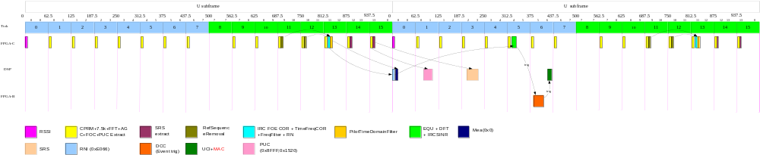
6. UL Timing
<number> | zCEM SW architecture | May 2009

Slide 18
contents
1.Concept of System Model
2.System Model High Level Functional Partition
3. BTS Module High Level Functional Partition
4. Downlink High Level Data Flow Description
5. Uplink High Level Data Flow Description
6. UL Timing
7. Use system model
<number> | zCEM SW architecture | May 2009

Slide 19
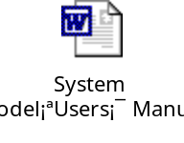
7 Use system model
The files useful for running:
<path>/current/include include files for building the program
<path>/current/bin/ltesim compiled executable program
<path>/current/mp_tags text file comprehensively listing available matchpoints
<path>/current/src/cfg directory contain many example configuration files
<path>/current/bin/b2a a “binary-to-ascii” data extraction tool
<number> | zCEM SW architecture | May 2009

Slide 20
7 Use system model
$ <path>/ltesim –l <length> -i <cfgfile> [-o <outfile>]
where:
<length> is the length of time you wish to run in units of “ticks” (1/16th of a 1 ms subframe = 62.5ms)
<cfgfile> (prepended optionally by full or relative path) is a plain text input configuration file, that completely specifies what operations the model will perform; optional for verification mode
(optional) <outfile> (prepended optionally by full or relative path) is a file into which the SM will write any output data it generates. This data is binary, i.e., not plain text, and must therefore in general be extracted using the b2a (“binary” to “ASCII”) extraction tool .
< outfile > is any previously generated SM output file
<number> | zCEM SW architecture | May 2009

Slide 21
7 Use system model
The path for the b2a tool is
<path>/current/bin/b2a
The usage of b2a tool is:
$ <path>/b2a – I <InputFile> -O<OutputDir>|-o<OutputFile>
<number> | zCEM SW architecture | May 2009

Slide 22
7 Use system model
Cfg file:
The LTE System Model configuration file is written in plain text and consists of a series of nodes demarcated by unique identifiers (i.e., names) and corresponding “End” commands.
  There are 7 top level nodes :Globals , Bts , Ue, Schedule ,WireChannel , SpatialChannel , JakesChannel
Each containing a series of parameters set in lvalue (“left-hand” parameter) = rvalue (“right-hand” allowable value) syntax .
  all text after “End” is ignored by the parser
  the sign: “=”, while customary, is not strictly required. The following statements:
    StartingSimulationTick = -1
    StartingSimulationTick -1
  are equivalent.
By custom, SM input files are suffixed: “.cfg”, but such use is not required.
<number> | zCEM SW architecture | May 2009

Slide 23
7 Use system model
syntax like the following:
  Globals
  BandWidth = 20MHz
  UlDlConfig = 1
  SpecialSfConfig = 7
  DumpData
  DumpTags = enable
  EnableTag = 55020
  EnableTag = 55030
  TagRange = 40000 40600
  End (DumpData)
  End Globals
<number> | zCEM SW architecture | May 2009

Slide 24
7 Use system model
Column, LrxSrsUserConfigMsg,AbsoluteTick,Index,Epsilon, UserId, IdftPass1, IdftStop1, IdftPass2
  LrxSrsUserConfigMsg,271,1,0,1,27,45,0
So 2 users being configured every 80 ticks (5 ms) for 5 such periods
Column, LrxSrsUserConfigMsg, AbsoluteTick,Index,Epsilon, UserId, IdftPass1, IdftStop1, IdftPass2
  LrxSrsUserConfigMsg, 31,0,0,0, 0, 9,135
  LrxSrsUserConfigMsg, 31,1,0,1,27,45, 0
  LrxSrsUserConfigMsg,111,0,0,0, 0, 9,135
  LrxSrsUserConfigMsg,111,1,0,1,27,45, 0
  LrxSrsUserConfigMsg,191,0,0,0, 0, 9,135
  LrxSrsUserConfigMsg,191,1,0,1,27,45, 0
<number> | zCEM SW architecture | May 2009

Slide 25
7 Use system model
Match Points:
(1)LTE SM matchpoint tag lines have the following format:
% <TagId> <Abs Tick> <Aux Tag 1> <Aux Tag 2> ...
Tag lines are always signified by a “%”, followed by “TagId” and “Abs Tick” columns that are provided automatically by the data dumping routines.
(2)Match point for test vector are :
UE transmitter : -10,-2000,-2010……
Interface : 4 PCI Bus data; 10 EMIF-B Bus data;16 SRIO Dump Data……
FPGA A : 30002,30003……33000
FPGA B : 10000, 10010 , 10011 ……10045
20100 , 20110 ……20190
FPGA C : 40000, 40001 ……40506
DSP : 50000 , 50010 ……55050
<number> | zCEM SW architecture | May 2009

Slide 26
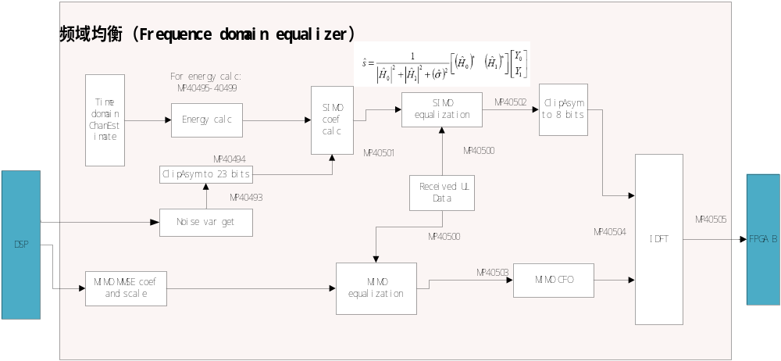
7 Use system model
Match Points:
The match point of the processing flow which are used to compare with DSP or FPGA outputs or as inputs are generated in some dedicated points.
Match Points map: \\172.24.186.40\public\xukew\AlignSD
Take FPGA C frequency equalization module for example:
<number> | zCEM SW architecture | May 2009

Slide 27
7 Use system model
The steps of running system model:
Step 1: use SceureCRT or other tool to login 172.24.186.40
Step 2: cd to ltesim directory
Step 3: ./ltesim –l length –i config_file –o bin_file
Step 4: ./b2a -i bin_file –O mpdir
Show PUCCH and PUSCH simulation example.
(1)configuration files (the syntax and parameter introduction)
(2)generate test vector of match points
<number> | zCEM SW architecture | May 2009

Slide 28

www.alcatel-lucent.com
<number> | zCEM SW architecture | May 2009

